Slide 1
Data Mining
& Discovery
Fang Jie
Li Zhiyuan
Group 9
Winter Is Coming
Notes:
1

Slide 2
Contents
Data Analysis
Preprocessing
Training
Improvement
Notes:
2

Slide 3
Data analysis
Data Structure
Data Visualization
Notes:
3

Slide 4
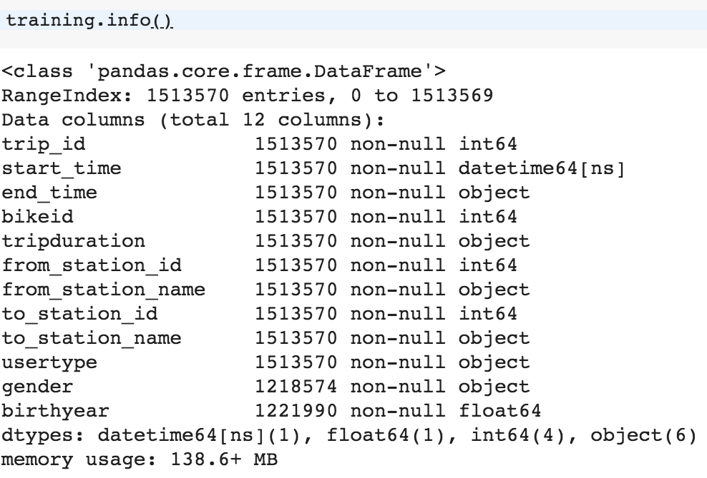
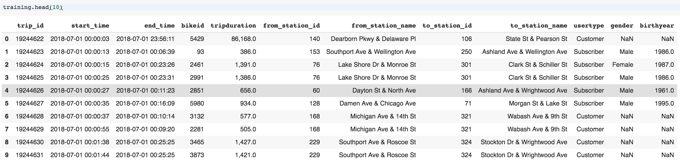
Data Structure
Notes:
4

Slide 5
Data Visualization
Time Visualization
Notes:
5

Slide 6
Data Visualization
Station Visualization
Top 10 popular start station
Top 10 popular end station
Notes:
6

Slide 7
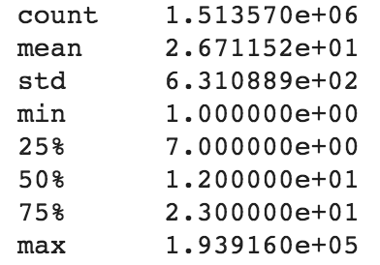
Data Visualization
Other Visualization
birthyear
Tripduration statistic
Notes:
7

Slide 8
Preprocessing
Data Reduction
Data Transformation
Data Cleaning
Data Integration

Slide 9
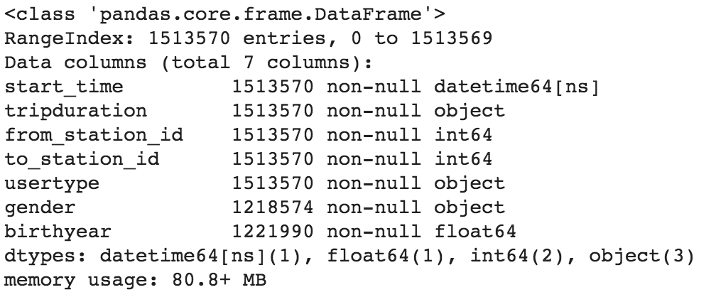
Data Reduction
Delete Attributes
We delete 'end_time', 'bikeid', 'from_station_name', 'to_station_name'

Slide 10
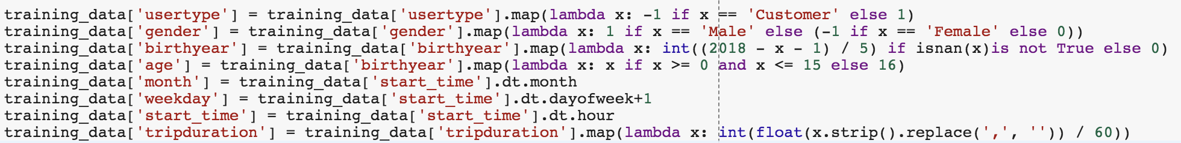
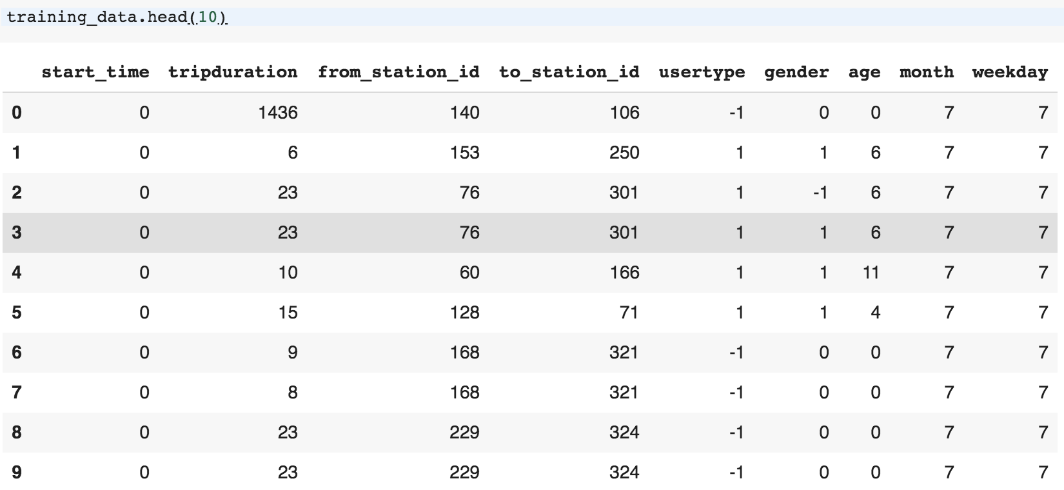
Data Transformation
Convert non-numeric data to be numeric
Convert birthyear to age
Age Discretization

Slide 11
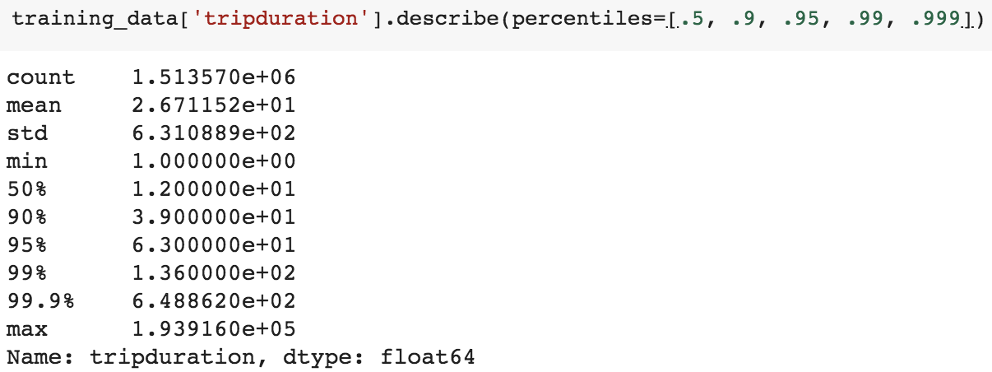
Data Cleaning
Delete noise that duration>600
Delete noise that age is too young or too old

Slide 12
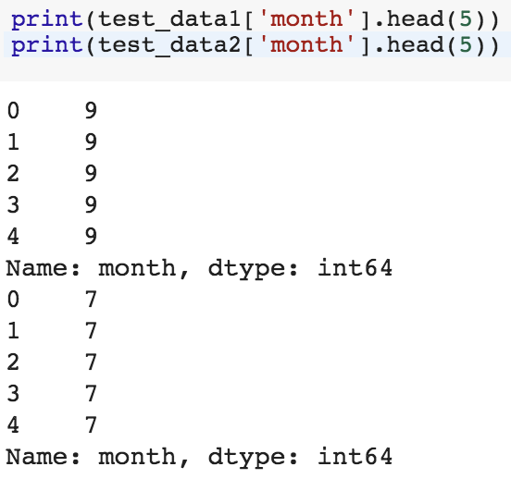
Data Integration
Month Integration
As we have finished data analysis, we know that the number of month in training data only has 7, 8, 9.
So we decide to change the month in test data to 7~9.
For Example, we change 6 to 7, 10 to 9.

Slide 13
Training
GBDT
Gradient Boosting Decision Tree
The main idea is it builds decision trees and it generalizes them by allowing optimization of an arbitrary differentiable loss function.
But it is too slow to run in our weak laptops.
KNN
The k-nearest neighbors algorithm is among the simplest of all machine learning algorithms.
An object is classified by a plurality vote of its neighbors, with the object being assigned to the class most common among its k nearest neighbors
Time complexity of KNN is O(n)
Insensitive to abnormal points

Slide 14
Training-KNN
The default parameters for API
class sklearn.neighbors.KNeighborsClassifier(
n_neighbors = 5,
weights = ‘uniform’,
algorithm =‘auto’,
leaf_size=30,
p = 2,
metric =‘minkowski’,
metric_params = None,
n_jobs = None,
**kwargs
)

Slide 15
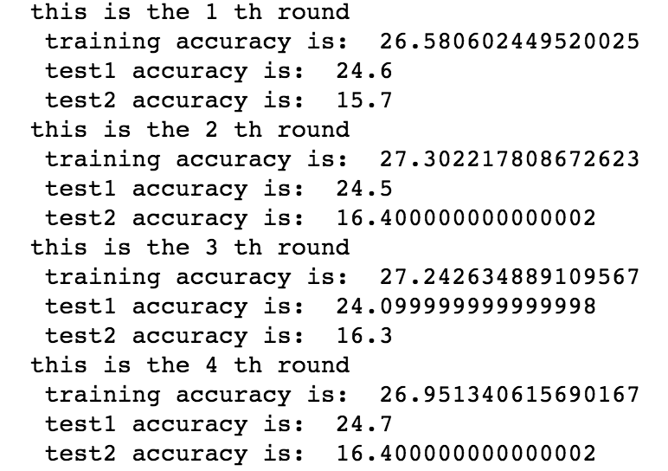
Training-KNN
Results

Slide 16
Training-KNN
Problem
The accuracy is very low, so we want to improve it.
How
Process the data again.
Change the training data structure.
Change the parameters in the training model.

Slide 17
Improvement
Data improvement
Model parameters optimization

Slide 18
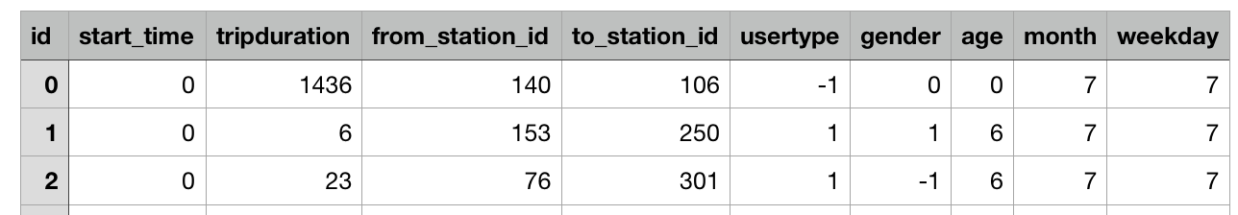
Data improvement
Original Data
We try to make changes to 4 of these attributes.
weekday
start_time
tripduration
age
Notes:
We first try to improve the data.
Each sample have 8 attributes and 1 labels.
We try to make changes to 4 of these attributes.(weekday, start_time, tripduration, age)

Slide 19
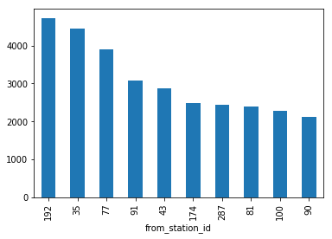
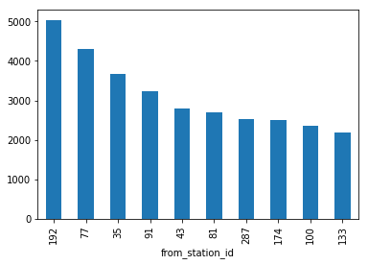
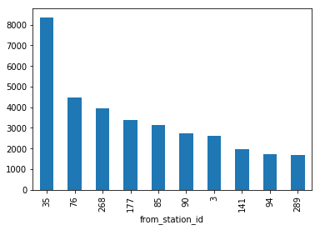
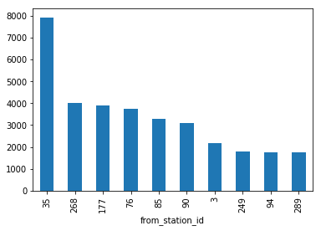
Data improvement
weekday Improvement
Notes:
As to the weekday
The above two pictures display top 10 to_station_id on Monday and Tuesday.
The below two picutres display top 10 to_station_id on Saturday and Sunday.
We find that the top10 to_station_id are almost same in weekday and they are quite different from weekend.
So we try to change the attribute weekday to weekend, 1 means weekend and 0 means weekday.

Slide 20
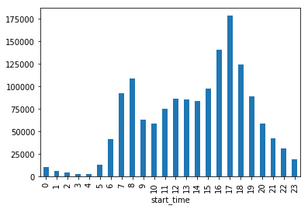
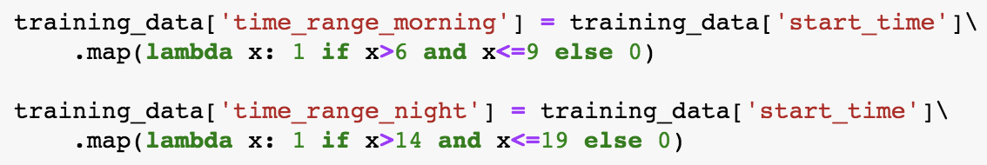
Data improvement
start_time Improvement
Notes:
Then is the start_time. we divide each day into 24 hours and count the trips taken at each hour, where the trips time denotes their starting time. As we can see, most of the trip are taken during the daytime from 7AM to 8PM and 15PM to 19PM.
So we try to add two attributes called morning_rush_hour and night_rush_hour. Means whether the trip taken during the morning rush hour and night rush hour

Slide 21
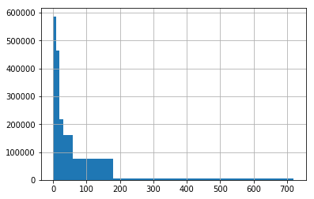
Data improvement
tripduration Improvement
Delete samples with tripduration > 600 mins
Delete samples with tripduration > 10000 mins
Notes:
Then is the tripduration.
Let look at the tripduration distribution figure.
We first remove trips with duration larger than 600 minutes.
But in connection with the actual phenomenon, most of the people who ride the longest are tourists, and the tourists may borrow the bike for whole week and most people won’t travel longer than 1 week, so we think that the duration more than one week is unreasonable.
So we delete the samples with a duration greater than 10,000 minutes

Slide 22
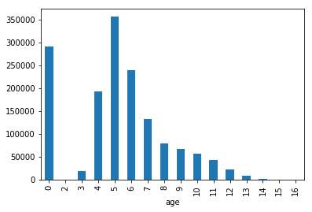
Data improvement
age Improvement
Set age 0 to 5 or 6 by portionally
Probability: 5(60%), 6(40%)
Notes:
At last is the age. The distribution of age shows below: we first set unknow age as 0
We can see that, people from 5 to 6 are more likely to ride bike. And the age of customers are unknow, so we set the age of customers to 5 and 6 proportionally.

Slide 23
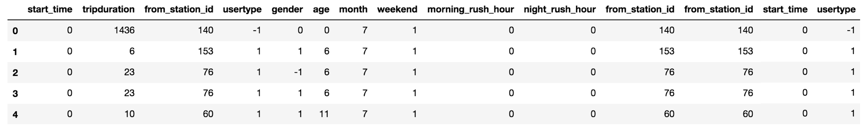
Data improvement
Copy Attribute
And we think that some attributes may have more weight than others.
Through the experiment, we finally decide to copy some of the attributes again.
Final Data
Notes:
And we think that some attributes may have more weight than others. Through the experiment, we finally decide to copy some of the attributes again.
The final data looks like that: we have 14 attributes totally.

Slide 24
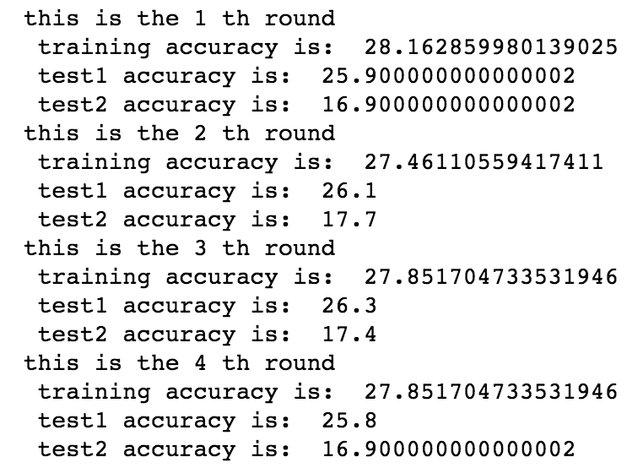
Data improvement
Before improvement
After improvement
Notes:
And this is the result after data improvement.

Slide 25
Model parameters optimization
sklearn.model_selection.GridSearchCV
Exhaustive search over specified parameter values for an estimator. There are total 8 parameters in knn, and we try to make change to 5 of them.
n_neighbors: Number of neighbors to use by default for kneighbors queries.
weights: weight function used in prediction.
algorithm: Algorithm used to compute the nearest neighbors:
leaf_size: Leaf size passed to BallTree or KDTree.
p : Power parameter for the Minkowski metric.
And the other 3 parameters we decide to use the default value.
Notes:
There are total 8 parameters in KNeighborsClassifier. And we try to change below parameters:
n_neighbors,: Number of neighbors to use by default for kneighbors queries.
weights: weight function used in prediction.
Algorithm: Algorithm used to compute the nearest neighbors:
leaf_size: Leaf size passed to BallTree or KDTree.
p : Power parameter for the Minkowski metric.
And the other 3 parameters we decide to use the default value.
Through the experiment, we found that when weight= ‘distance’ , algorithm=‘kd_tree’
, p=1(manhattan_distance), the model performs much better.
Then we use GridSearchCV from sklearn to search the best n_neighbors and leaf_size.
It’s a exhaustive search over specified parameter values for an estimator.
But it’s pretty slow

Slide 26
Model parameters optimization
Final result
Comments
There are 2 factors leads to such bad performance
Training set and test set belong to different months
Number of target stations is too large
Notes:
And the final result is that:
This is the best result we get .
And the final performance is still not good. I think bad performance in this forecast is due to two factors, one is that the months of the data in training set and test set are different, different months will have different climates. And the number of target stations is too large, which is another factor that leads to inaccurate predictions

Slide 27
THANK YOU
FOR WATCHING
Q&A
Group 9
Winter Is Coming

